Slide 1

Modelling global transient palaeoclimate
The last deglaciation 26-11 ka
Ruza Ivanovic

Slide 2
Challenges in global, transient modelling
The last deglaciation
  What was the chain of events?
Modelling this period
  Uncertainty in the boundary conditions
Abrupt warming and rapid sea level rise
(When there is uncertainty in timing)
How can we unpick chains of events to construct model boundary conditions?
How can we globally correlate records to evaluate our results?

Slide 3
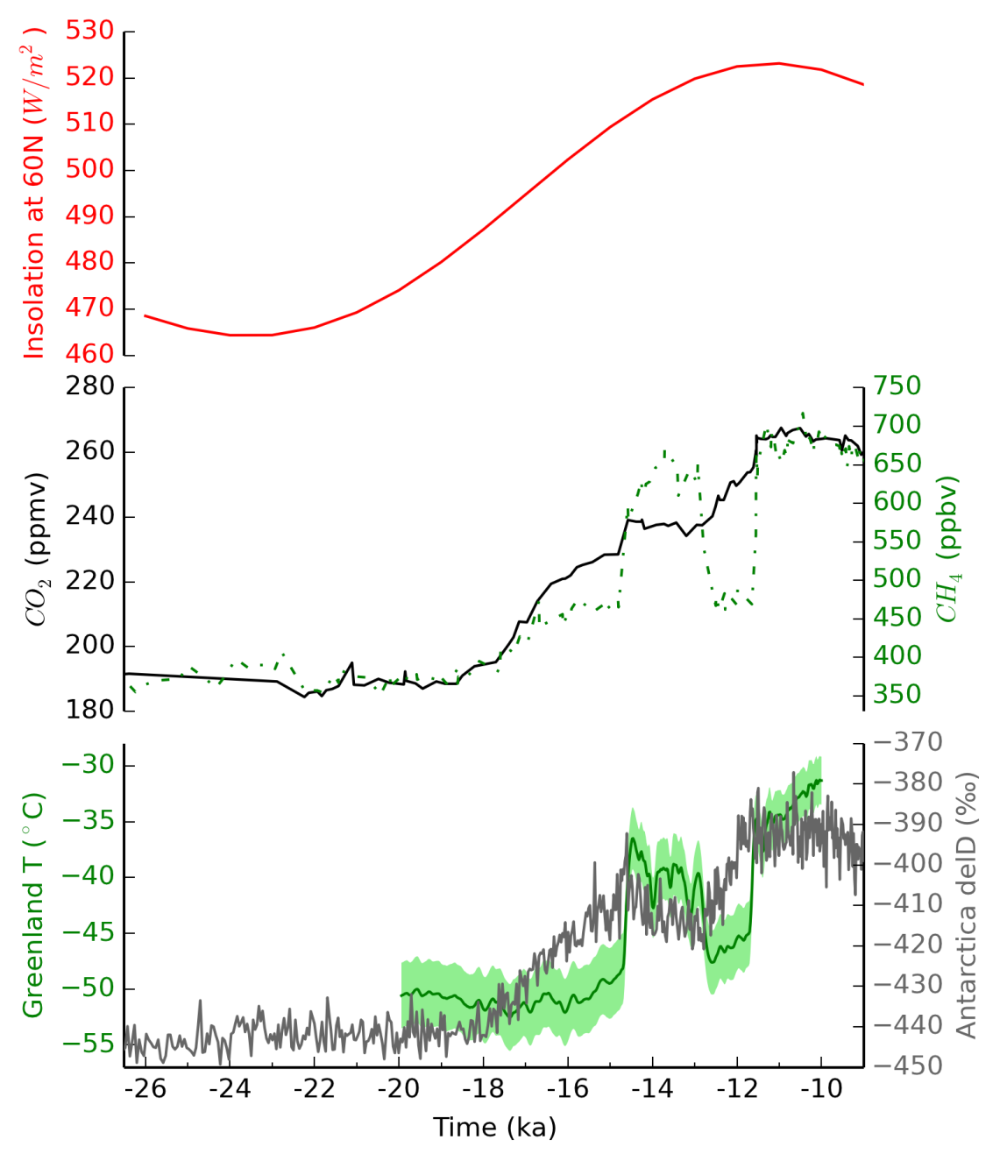
The last deglaciation
Buizert et al. (2014)
Jouzel et al. (2007)
Veres et al. (2013)
LGM

Slide 4
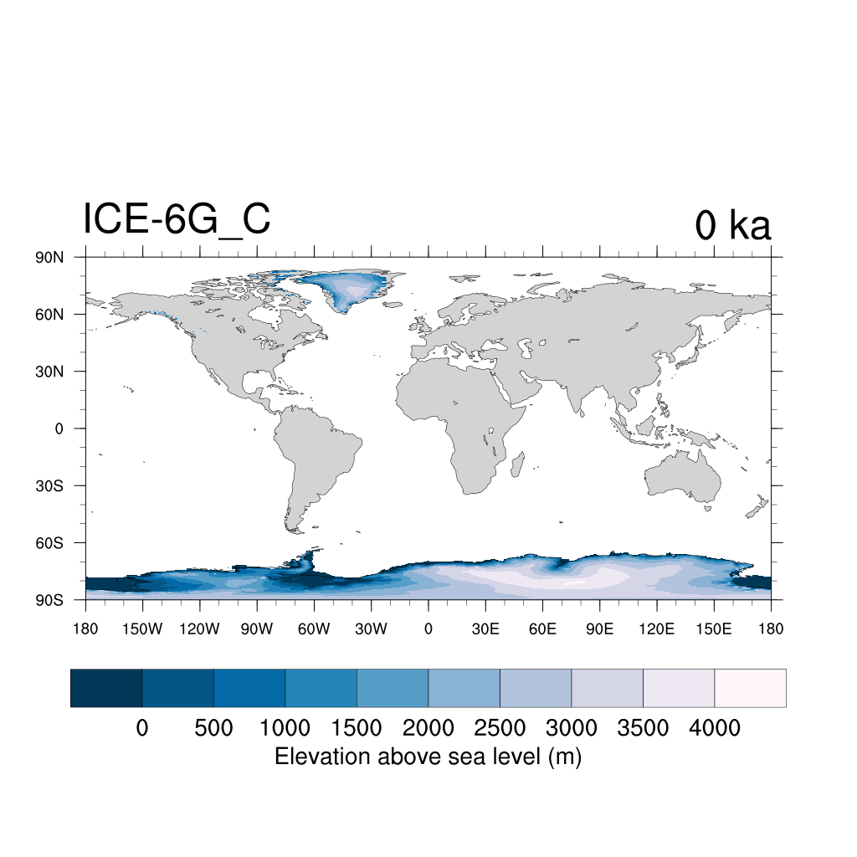
ICE6G_C (VM5a) reconstruction 0 ka
Argus et al. (2016), Peltier et al. (2015)

Slide 5
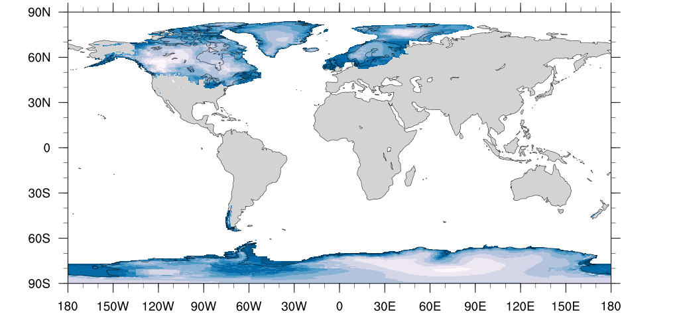
ICE6G_C (VM5a) reconstruction 26 ka
Argus et al. (2016), Peltier et al. (2015)

Slide 6
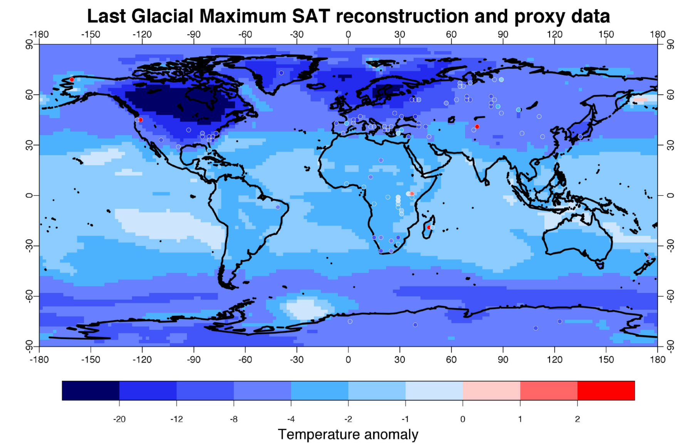
-20
-12
-8
-4
-2
-1
0
1
2
Temperature anomaly °C
Global mean cooling of
4.0 ± 0.8 °C(wrt pre-ind)
Annan & Hargreaves (2013)

Slide 7
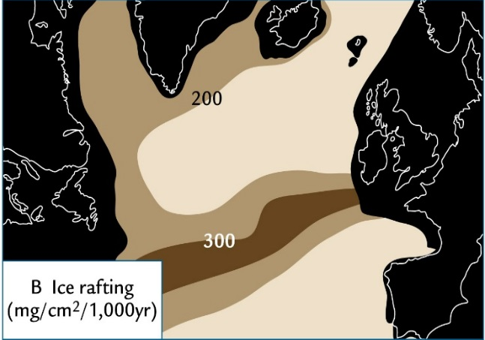

The last deglaciation
HS1
Ruddiman (2014)
Buizert et al. (2014)
Jouzel et al. (2007)
Veres et al. (2013)
H1
LGM

Slide 8
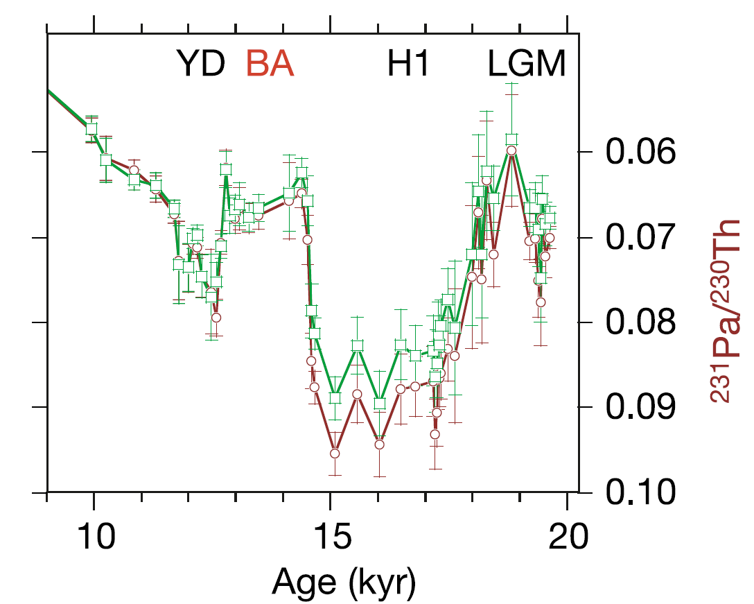
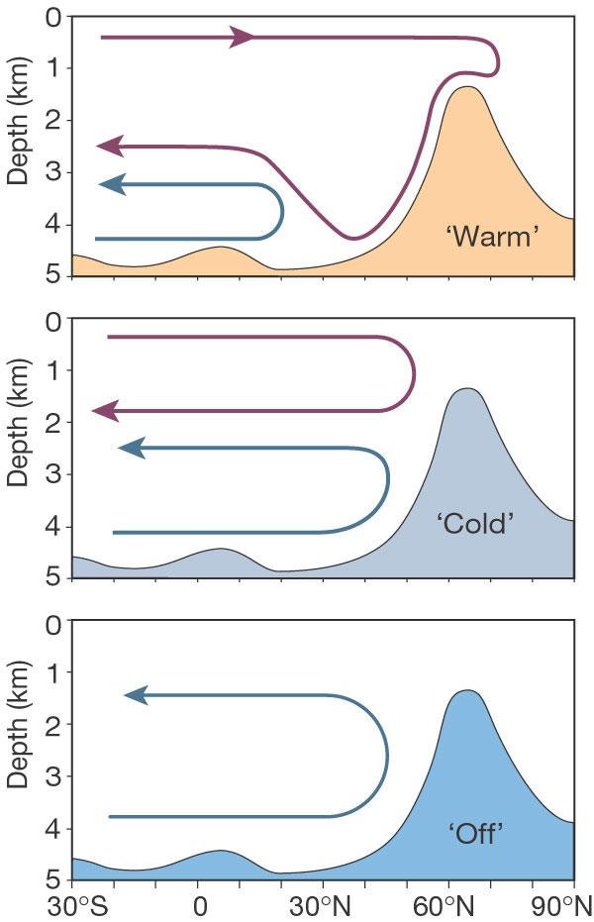
HS1: Atlantic Ocean circulation
HS1
McManus et al. (2004)
H1
²³¹Pa/²³⁰Th
AMOC strength
Rahmstorf (2002)

Slide 9
The last deglaciation
Bølling Warming MWP1a
HS1
Buizert et al. (2014)
Jouzel et al. (2007)
Veres et al. (2013)
H1
LGM

Slide 10
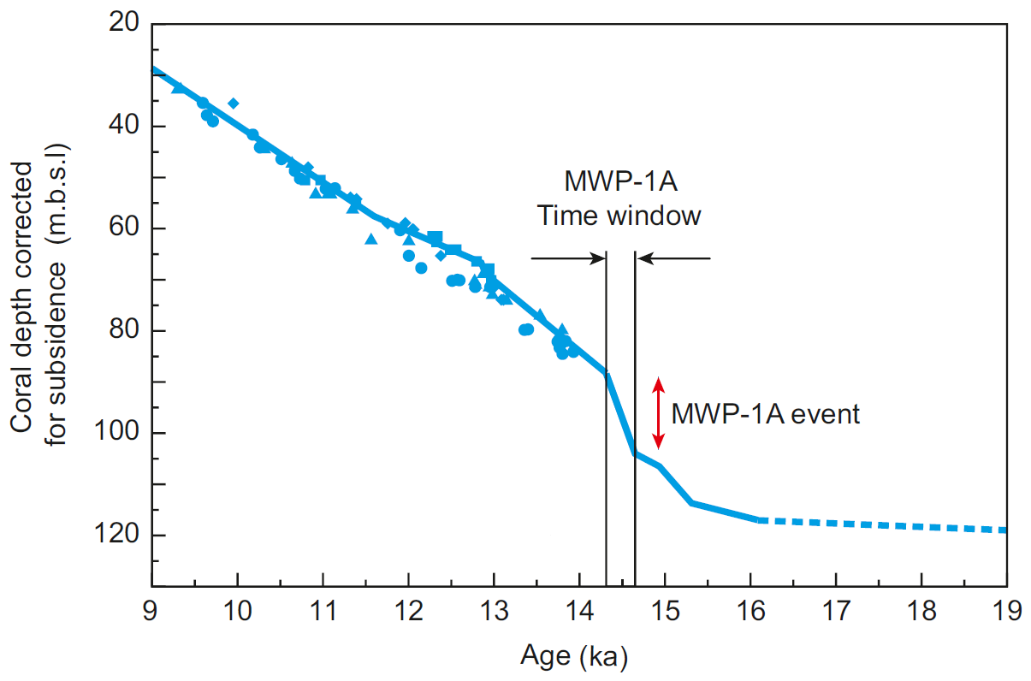
Meltwater Pulse 1a: Tahiti
MWP1a time window
(Relative sea level below present, m)
MWP1a event
Deschamps et al. (2012)
12-22 m in < 340 years
19 18 17 16 15 14 13 12 11 10 9

Slide 11
The last deglaciation
Bølling Warming MWP1a
HS1
Buizert et al. (2014)
Jouzel et al. (2007)
Veres et al. (2013)
H1
ACR
YD
LGM

Slide 12
Questions to answer (examples)
What drove the deglaciation climate patterns?
How/why do we get abrupt climate events?
Can we simulate rapid change with realistic forcings?
What is the role of:
  Ocean circulation?
  Ice sheets (albedo, orography, melt)?
  CO₂ and orbit?
Do the mechanisms of climate change differ depending on background state and/or model?

Slide 13
Modelling the last deglaciation
PMIP working group
International project
> 65 participants
Core simulation (21-9 ka)
Focused simulations
Data compilation
Multidisciplinary expertise
Range of models
MODELLING
RECONSTRUCTION
State-of-the-art Earth System models
Faster Intermediate Complexity models

Slide 14
What do we need to know?
Key boundary conditions and forcings for driving the simulations
4D climate data to evaluate the results
  (+ knowledge of how to relate indirect measures of climate to model output)

Slide 15
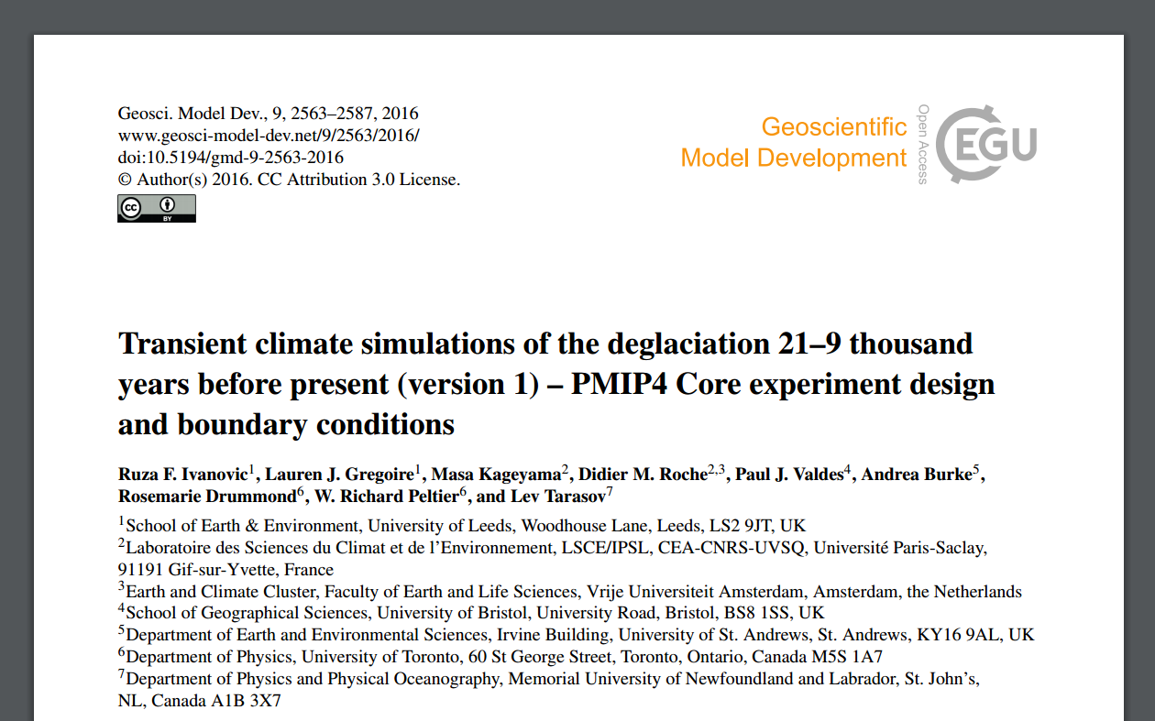
Boundary conditions
Astronomical parameters
Greenhouse gases
Ice sheets & palaeogeographies
  Including freshwater fluxes
Others:
  Land surface changes
  Atmospheric aerosols
  …
Full protocol:
Ivanovic et al. (2016) GMD

Slide 16
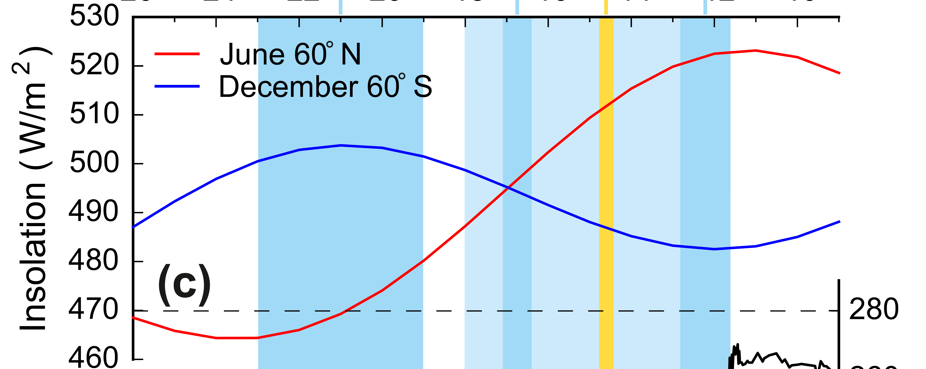
Astronomical parameters
Berger (1978)

Slide 17

Greenhouse
Gases
Bereiter et al.
(2015)
Loulergue et al.
(2008)
Measured in ice cores
Globally well mixed
Schilt et al.
(2010)

Slide 18
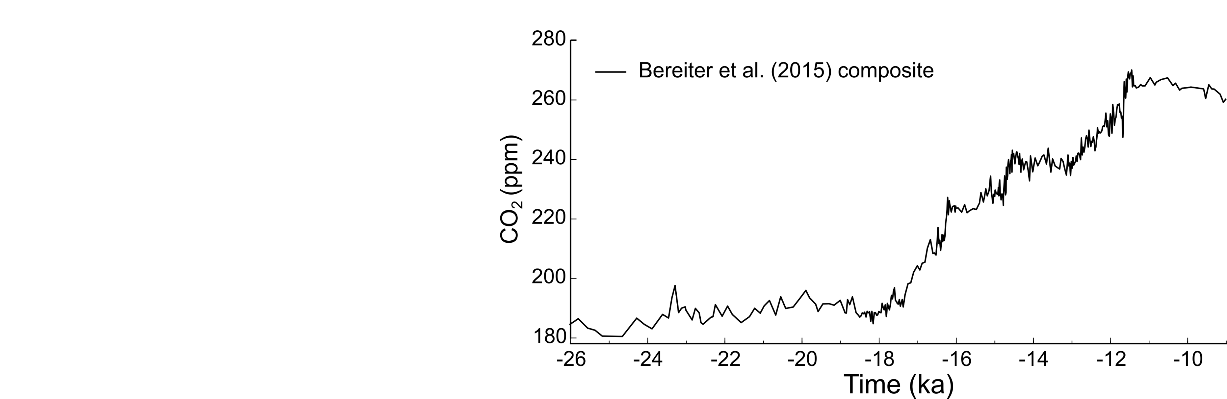
A closer look: CO₂ records

Slide 19
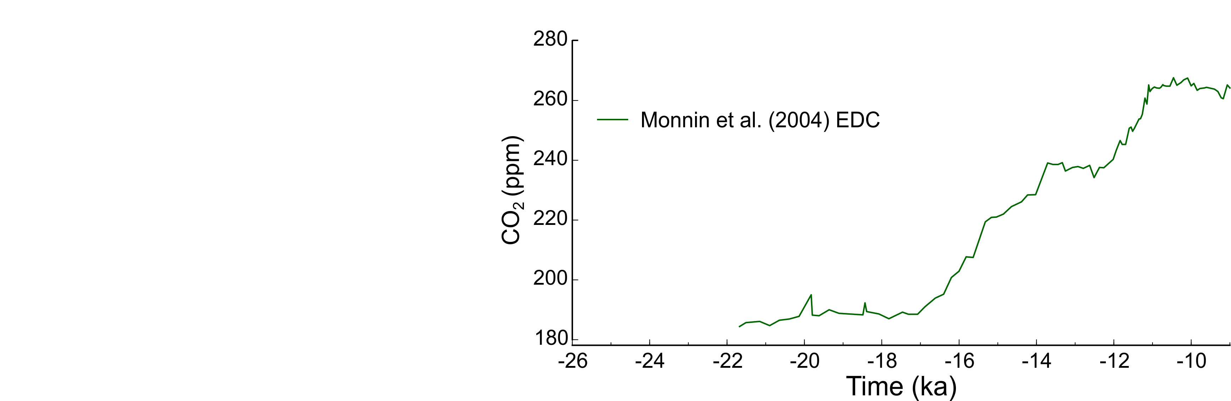
A closer look: CO₂ records

Slide 20
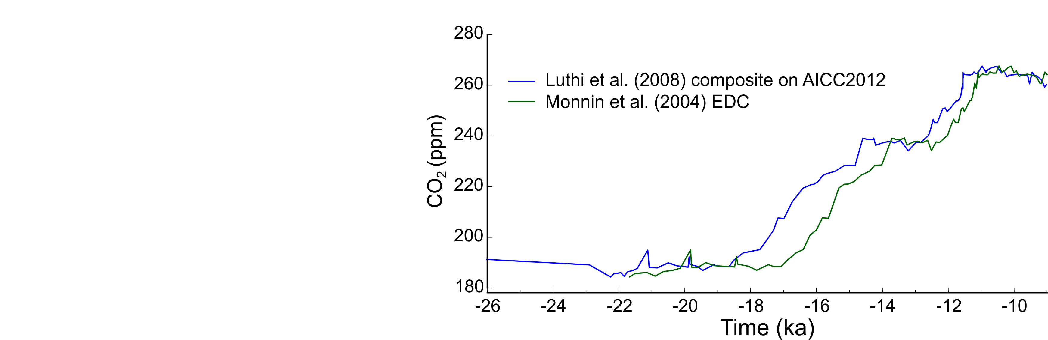
A closer look: CO₂ records

Slide 21
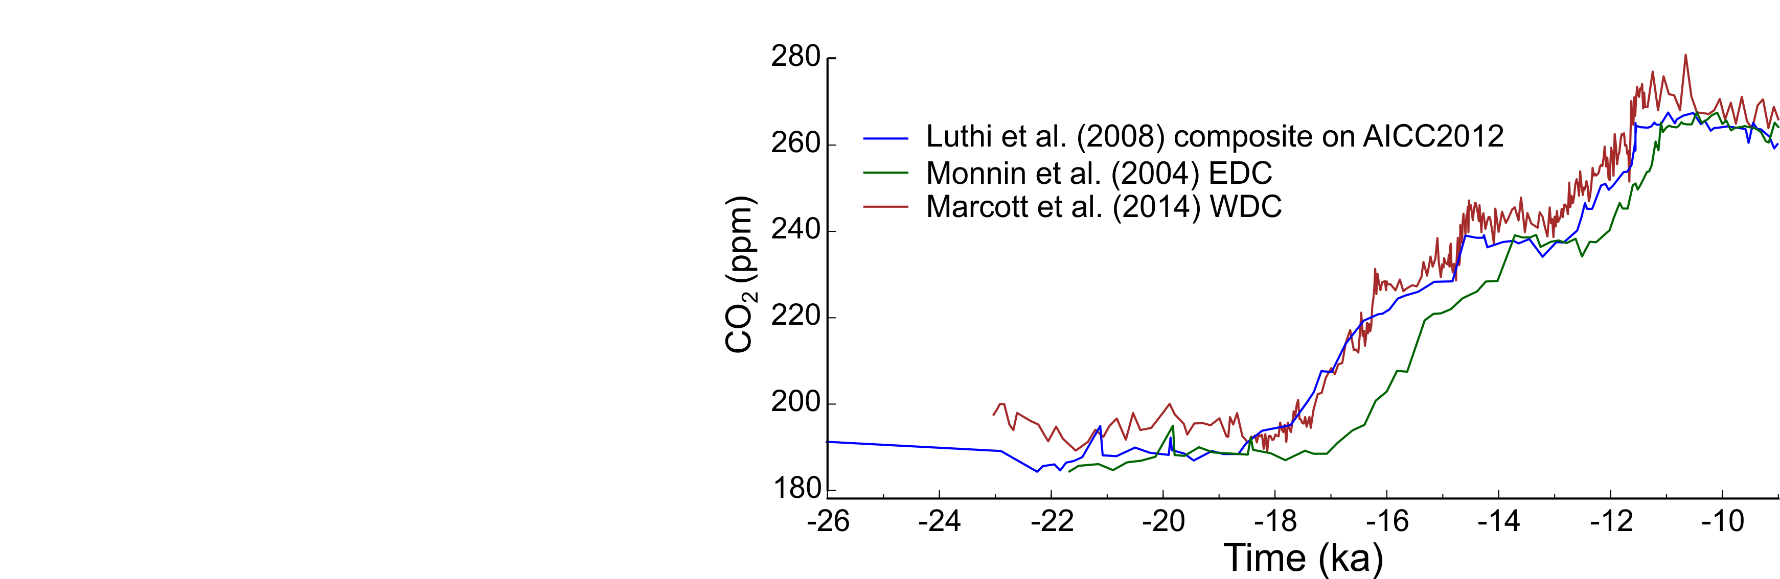
A closer look: CO₂ records

Slide 22
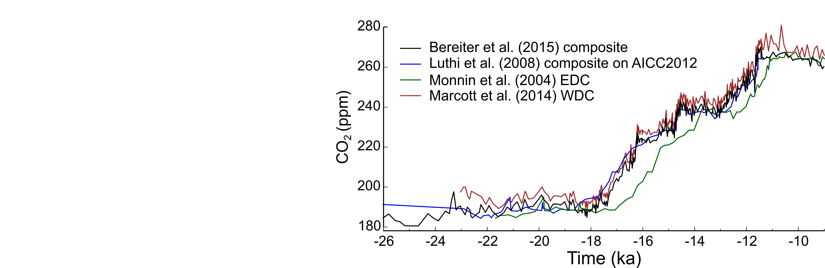
A closer look: CO₂ records

Slide 23
A closer look: CO₂ records
Variability?
Resolution?

Slide 24
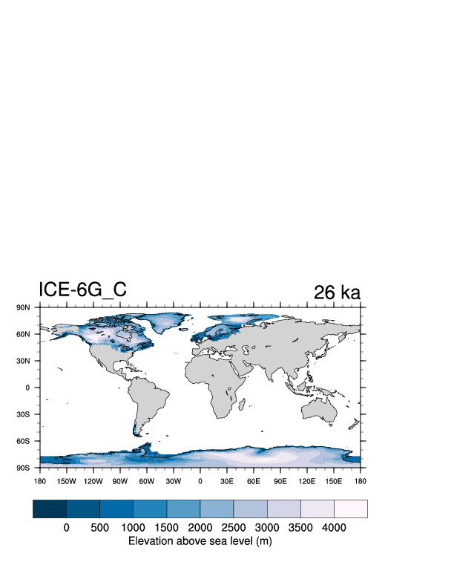
Ice sheets (& palaeogeographies)

Slide 25
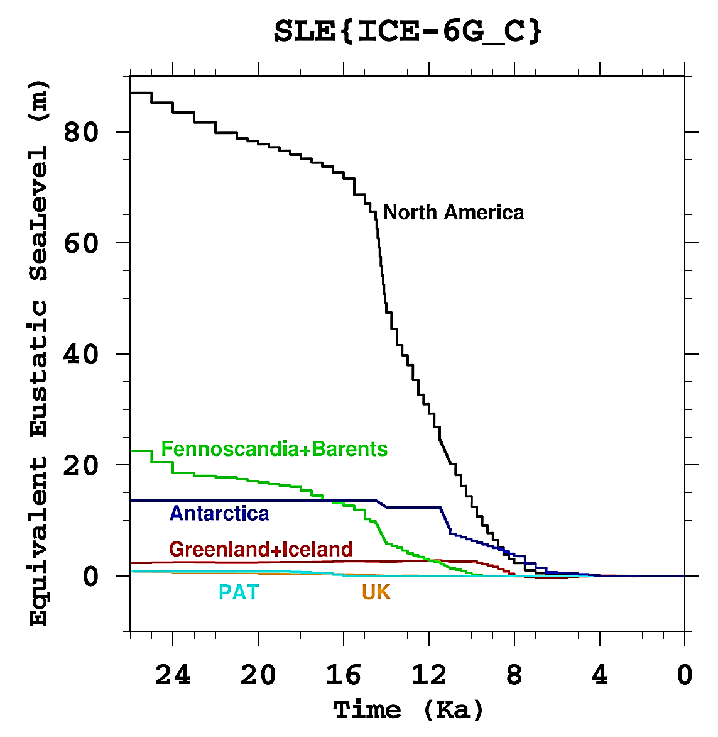
ICE-6G_C relative to present day
35
30
25
20
Ice volume (10⁶ km³)
15
10
5
0
0

Slide 26
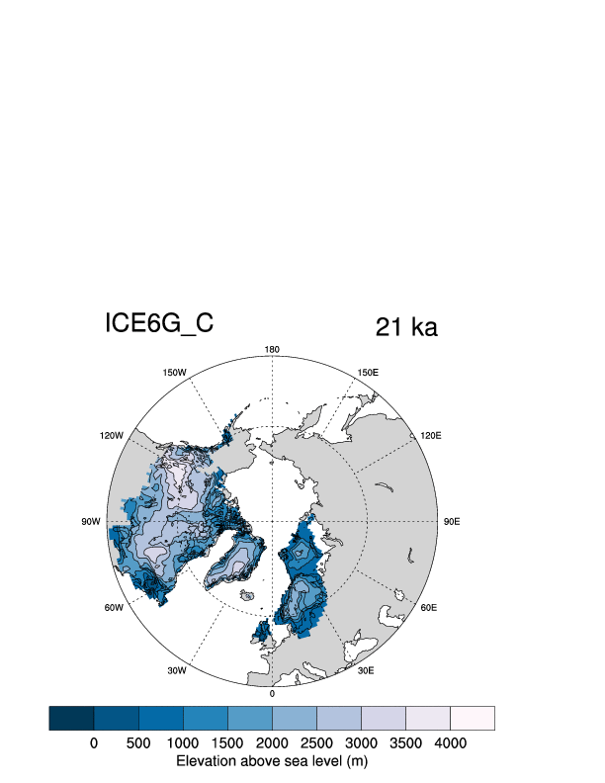
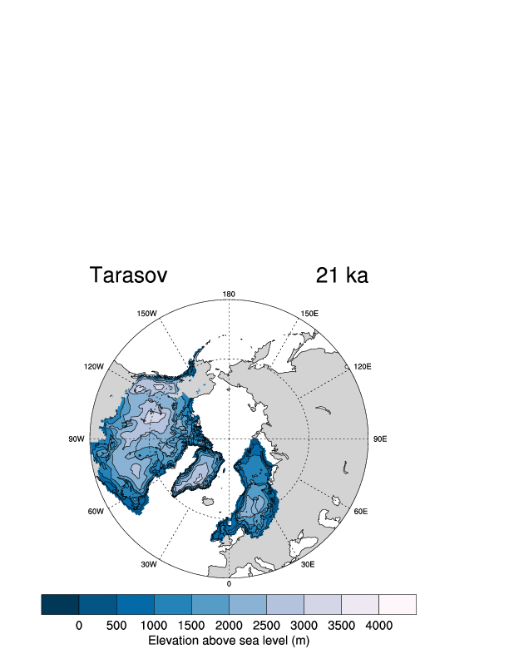
Different reconstructions
ICE-6G_C
GLAC-1D
[80%]

Slide 27

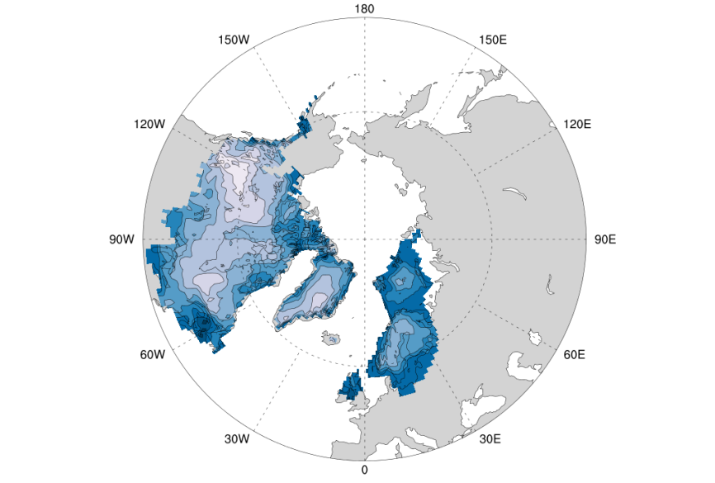
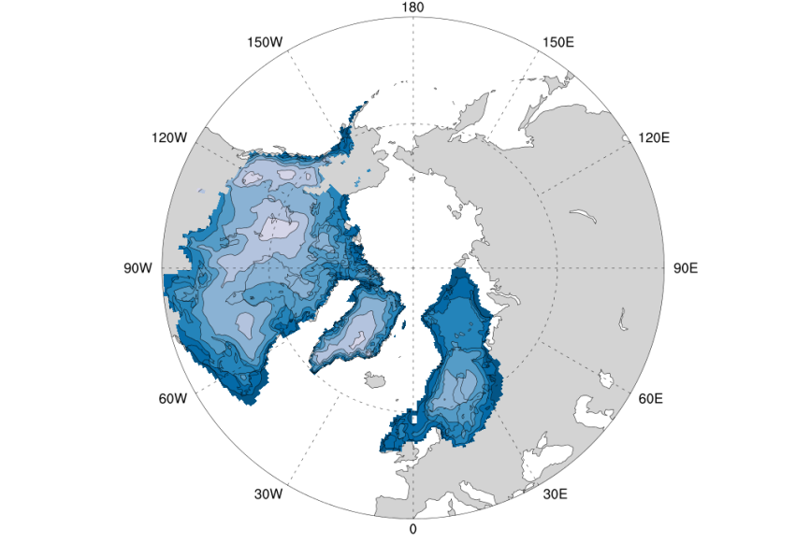
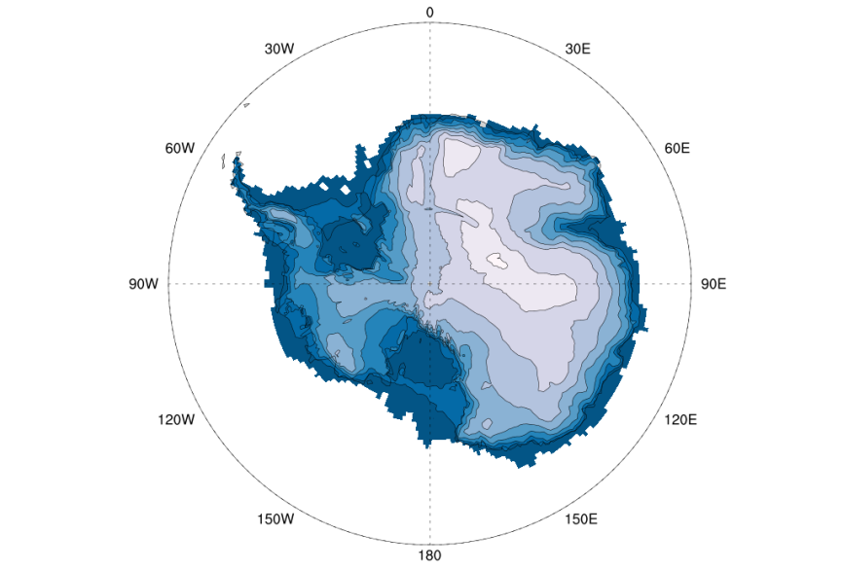
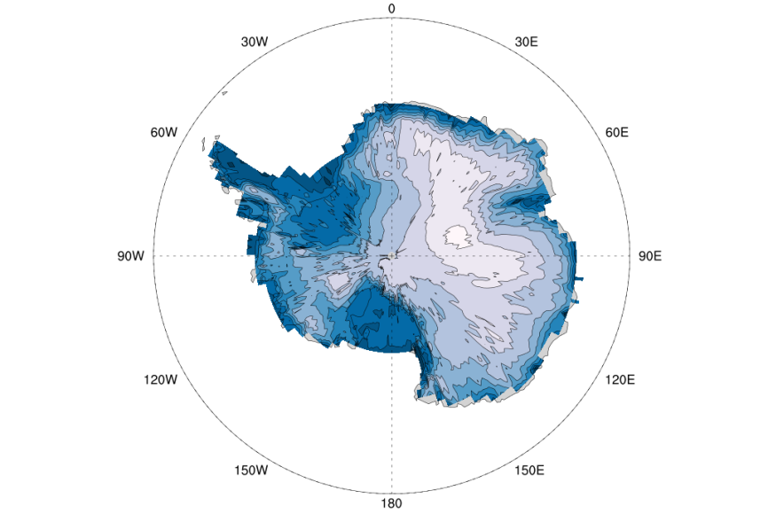
Different reconstructions
ICE6G_C 21ka
GLAC-1D 21ka

Slide 28
Freshwater fluxes
Rahmstorf (2002)
Important drivers of ocean circulation change
~130 m global sea level equivalent of ice melted
  Could be considered min.
When, where, how much and for how long?

Slide 29
Freshwater fluxes: location matters

Slide 30
Freshwater fluxes: location matters

Slide 31
Freshwater fluxes: location matters

Slide 32
Freshwater flux challenges
Few independent records of fluxes
Uncertain ice sheet evolution (2 choices)
Ice sheet reconstructions do not capture everything:
  Coarse C-scale timesteps miss the fast pulses
  Ice shelves & icebergs may not be included
Routing highly sensitive to surface change
Model structure: how freshwater is handled

Slide 33
Some constraints
Approximate volumes from ice sheet reconstructions and sea level records
Rough idea of long-term melt rates
Multi-centennial to millennial windows for short pulses
Lacking detail:
When, where, how much and for how long

Slide 34
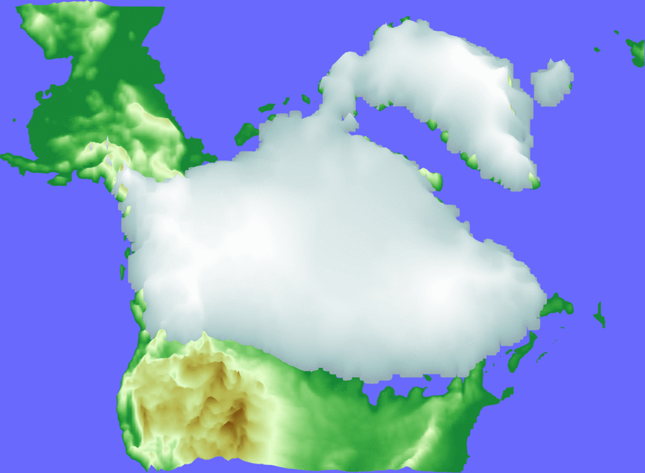
MWP1a: 12-22 m in < 340 years
North American ice sheet simulation
~7.3 m sle in 340 yrs
Consistent with ice sheet reconstructions
(Dyke et al., 2004; Peltier et al. 2015; Gowan et al., 2016)
Consistent with latest MWP1a fingerprinting
(Gomez et al., 2015, GRL)
Gregoire et al. (2012)

Slide 35
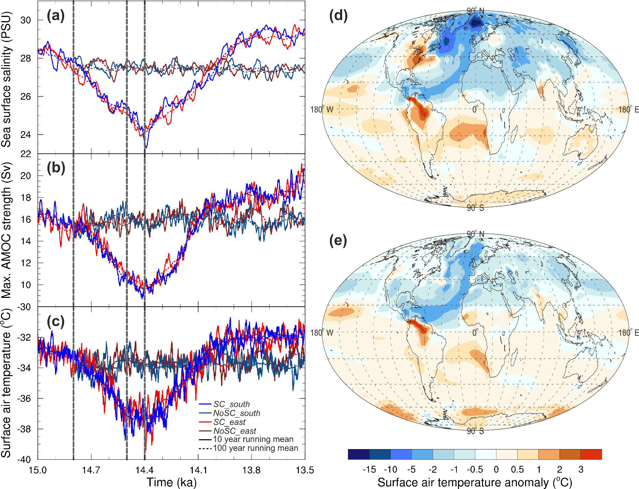
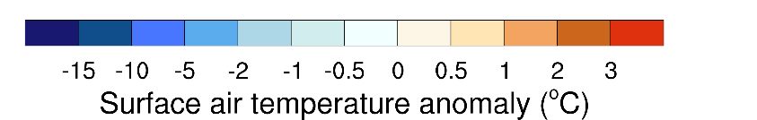
MWP1a: 12-22 m in < 340 years
AMOC weakening of ~40%
Widespread northern cooling
Around 14.5 ka
Dec-Jan-Feb
Jun-Jul-Aug

Slide 36

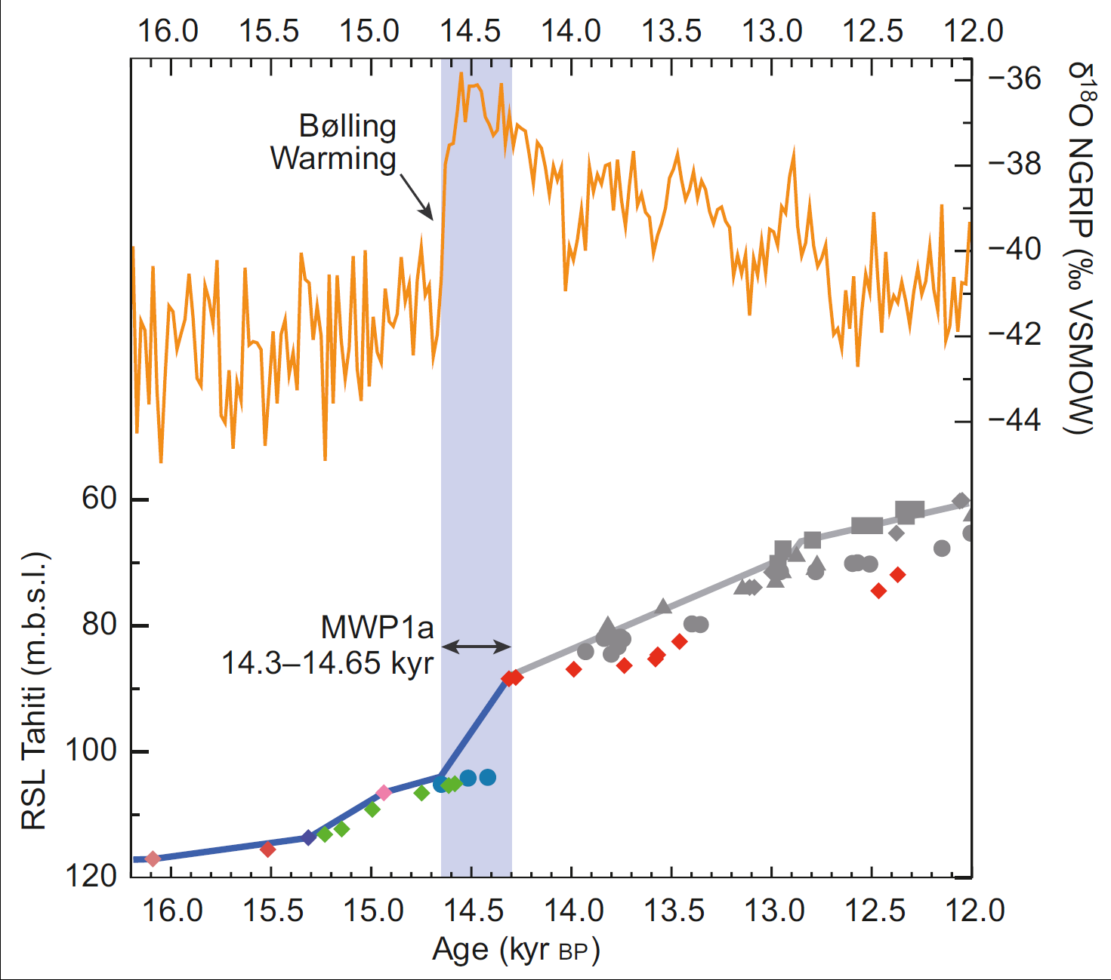
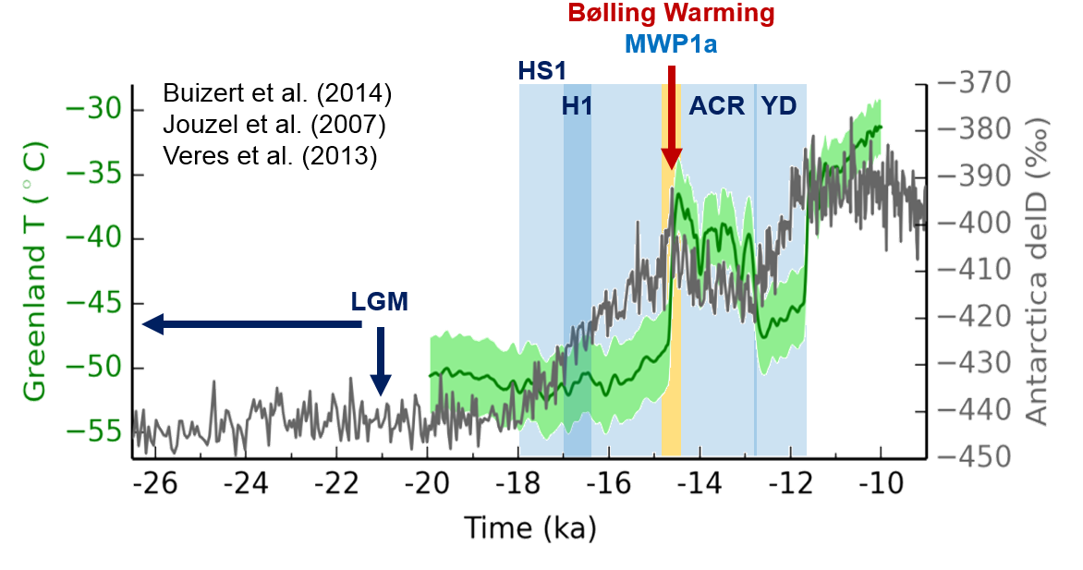
Chain of events?
After Deschamps et al. (2012)
~14.5 °C
?
Temperature
Warming → MWP1a → Cooling ?
?
?
?
Other melt?

Slide 37
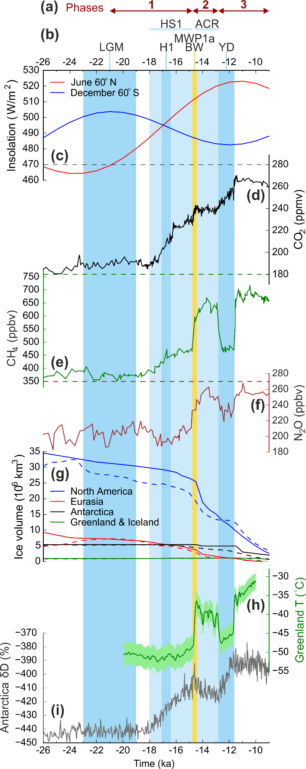

Mechanisms
Uncertainty in absolute and relative dates
No common age model
What were the chain of events?
Surface climate
Ice melt
Sea level
Ocean circulation
Greenhouse gases

Slide 38
Global, transient modelling
Expensive simulations
    Complex to setup
    Long run-time
    Large output
Valuable results!
(When there is uncertainty in timing)
How can we unpick chains of events to construct model boundary conditions?
How can we globally correlate records to evaluate our results?

Slide 39
Modelling global transient palaeoclimate
The last deglaciation 26-11 ka
Ruza Ivanovic

Slide 40
MWP1a: 12-22 m in < 340 years
1.4 m
+
0.4 m
7.3 m
Dec-Jan-Feb
Jun-Jul-Aug

